Slide 1



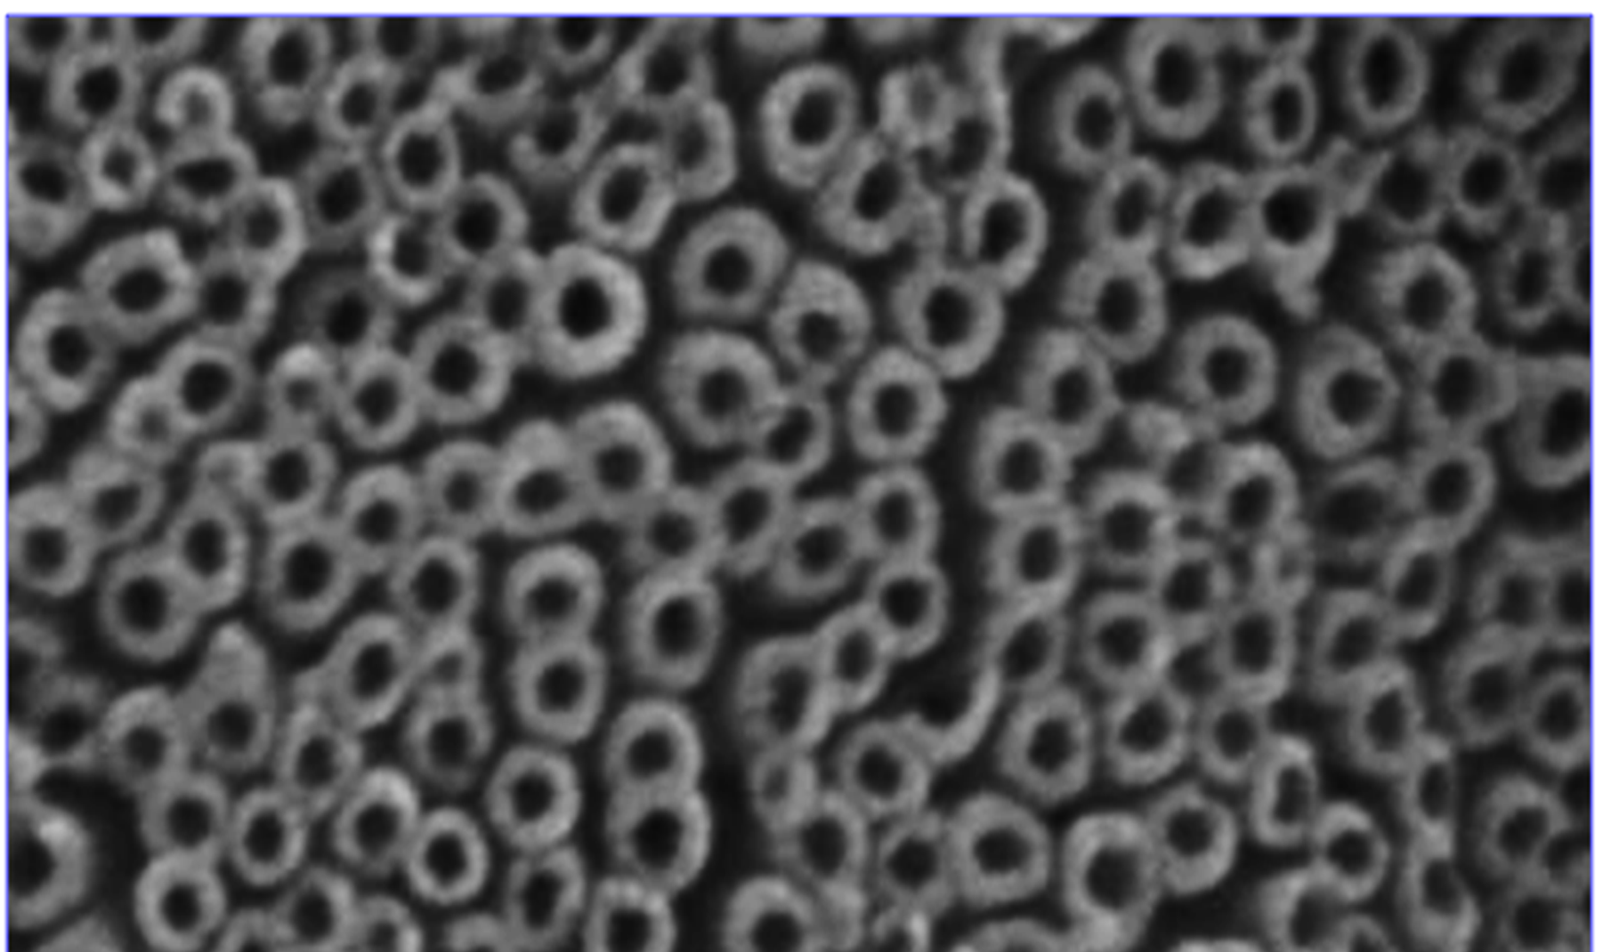

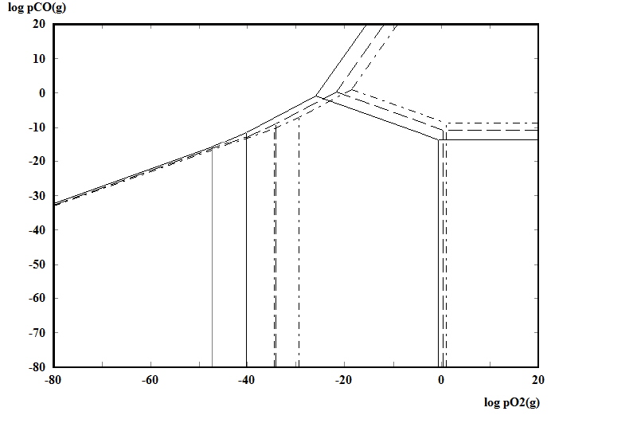
Preparation of Your poster(Title)
A. Presenter of the Paper, C. Corresponding Author
Department of ….., Hamedan University of Technology,
Hamedan,65155, Iran.
(Corresponding Author@hut.ac.ir)
Hamedan University of Technology
Dec 2024
National Research & Technology week
Abstract
This instruction provides guidelines for preparing poster for national research & technology week in Hamedan University of Technology. Authors should present materials, methods, instrumentations, software, and experimental procedures briefly. Please identify the suppliers’ complete name (companies) which provided the materials and equipment.
Results and Discussion
Even through the text use Equation Editor for mathematical parameters.Abbreviations should be explained when they appear in the text for the first time.
Keywords : Max. 5 Keywords, 10 regular and separated with “;”
Introduction
Authors should present materials, methods, instrumentations, software, and experimental procedures briefly. Please identify the suppliers’ complete name (companies) which provided the materials and equipment.
Use high resolution figures with readable scale bar and show the details by arrows.
Materials and method
All illustrations, formulas, figures and tables should be numbered throughout the text orderly. Do not assemble figures at the end of your paper, but place them as close as possible after they are mentioned in the text. All figures and diagrams should have readable scale-bars or legends. Authors should present materials, methods, instrumentations, software, and experimental procedures briefly. Please identify the suppliers’ complete name (companies) which provided the materials and equipment
Fig. 2 Example of a figure caption
Conclusions
The importance of the work and the significance of the achievements should be highlighted in conclusion part. Avoid repeating the abstract as the conclusion. The importance of the work and the significance of the achievements should be highlighted in conclusion part. Avoid repeating the abstract as the conclusion.
BaCO
BaCO₃
T (ᵒc)
800
950
1100
References
[1]. Habashi .F, 1997, Hand Book of Extractive Metallurgy,Vol 4, Ferroalloy metals, alkali metals, alkalin earth metals, part thirteen.
[2]. E. Jamshidi, H. Ale Ebrahim, 2008. A new clean process for barium carbonate preparation by barite reduction with methane. Chemical Engineering and Processing, 47, 1567–1577.
[3]. Y. Plovski, Kr. Ninova, I. Gruncharov, I. Dombalov, 1990. Isothermal Reduction of Barite With Hydrogen. Journal of Thermal Analysis, 36,2037-2043.
[4]. P.S. Hlabelaa,b, H.W.J.P. Neomagusa, F.B. Waandersa, O.S.L. Bruinsmaa. 2010. Thermal reduction of barium sulphate with carbon monoxide A thermogravimetric study. Thermochimica Acta, 498, 67–70.
[5]. D. Guzman, J. Fernandez, S. Ordonez, C. Aguilar, P. A. Rojas, D. Serafini, 2012, Effect of mechanical activation on barite carbothermic reduction. International Journal of Mineral Processing, 102-103, 124-129.
[6]. A.Salem, S.Jamshidi, 2012. Effect of past humidity on kinetics of carbothermal reduction of extruded barite and coke mixture. Solid State Sciences, (14), 1012-1073.
[7]. S. Jamshidi, A, Salem, 2010. Role of extrusion process on kinetic of carbothermal reduction of barite, Thermochimica Acta, 503, 108-114.
Ba
BaO
BaO₂
Fig. 1 Example of a figure caption.
Approval

